Slide 1

GLOBAL TRADE ANALYSIS
(TABLEAU)
DONE BY AKILESHWARAN.R

Slide 2
INTRODUCTION
LETS GET STARTED !
SLIDE 1

Slide 3

WHAT IS
GLOBAL TRADE?
GLOBAL TRADE IS ALSO KNOWN AS INTERNATIONAL TRADE, WHICH IS SIMPLY THE IMPORT AND EXPORT OF GOODS AND SERVICES ACROSS INTERNATIONAL BOUNDARIES.
GOODS AND SERVICES THAT ENTER INTO OUR COUNTRY ARE KNOWN AS IMPORTS.
GOODS AND SERVICES THAT LEAVE OUR COUNTRY FOR SALE IN ANOTHER COUNTRY ARE CALLED EXPORTS.
EX :- A COUNTRY MAY IMPORT WHEAT BECAUSE IT DOESN’T HAVE MUCH ARABLE LAND, BUT EXPORT OIL BECAUSE IT HAS OIL IN ABUNDACNCE.
SLIDE 2

Slide 4


ABOUT THE DATA
The data is a collection of import and exports of 12 major commodities including the commodity name, year(1988 to 2017), Trade amount in USD & quantity.
The list of products that are traded frequently in more quantity between countries are listed.
Live animals. Meat and edible meat. Fish and aquatic invertebrates. Dairy products and animal products. Products of animal origins. Live trees, plants, roots, bulbs, flowers. Edible vegetables and certain roots and tubers. Edible fruits, nuts, peel of citrus fruits. Coffee, tea, and spices. Cereals. Milling products, malt, starches, wheat. Oil seed, fruits, seeds, grains etc.

Slide 5

USING
TABLEAU PUBLIC
TRADE VISUALIZATION
IN THESE SLIDES, WE WILL HAVE A CLEAR OBSERVATION OF OUR DATA SET BY BLENDING THEM INTO A SOFTWARE AND CONVERTING OUR DATA IN MULTIPLE DIFFERENT CHARTS AND GRAPHS TO HAVE SOME PRODUCTIVE INSIGHTS.
SLIDE 4

Slide 6
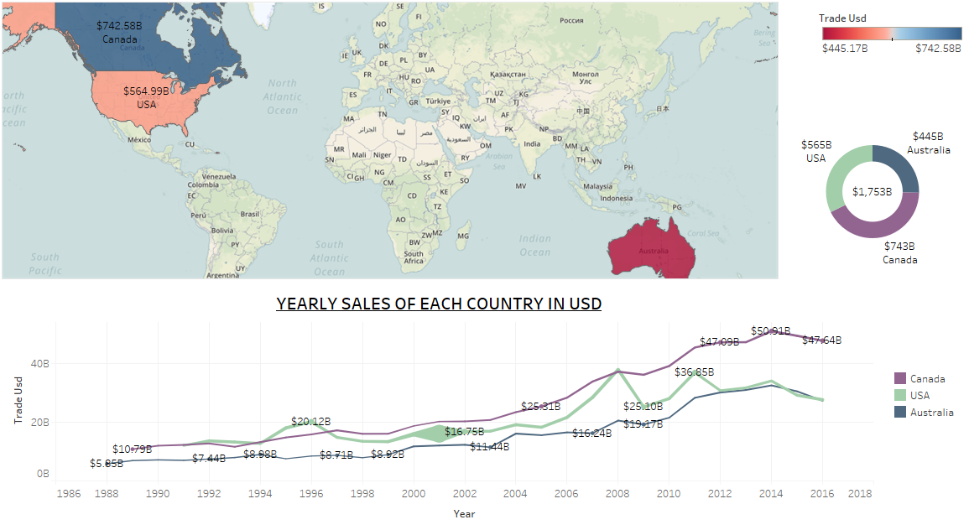
SLIDE 5

Slide 7



DASHBOARD - 1
WORLD MAP
On this chart we get an idea of the exact location of the countries given in our dataset.
PIE CHART
This chart shows the overall sum of sales for each country.
LINE CHART
It shows the yearly sales of all the 3 countries in dollars.
INFERENCES FROM THE DASHBOARD
Among all the three countries Canada trades goods at high money value [742.58 billion dollars].
We have data of USA from the year 1991 , Australia from the year 1988 and Canada’s data from the year 1989.
In the year 2001 USA traded ‘735.82B’ KG of goods in which ‘Live animals’ and ‘cereals’ contributed the most.
Country trading with higher quantity of commodities is USA.
In the year 2008, USA traded their highest trade value of ‘$37.83B’ with an average quantity of ‘109.87B’ kg, that includes products such as ‘Cereals’ and ‘Live animals’.
Compared to all 3 countries, Canada reached the highest trade value of ‘$ 51B’ in the year 2008.
SLIDE 6

Slide 8
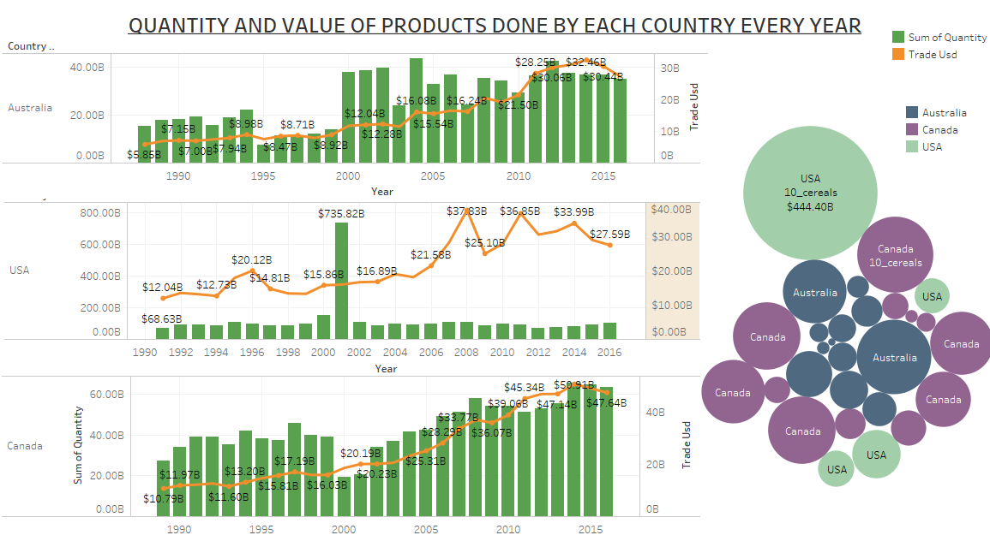
SLIDE 7

Slide 9


DASHBOARD - 2
BAR CHARTS
On this chart we get an idea of quantity of each products traded respective of each country every year.
BUBBLE CHART
Bubble chart shows the clear idea of the sum and quantity of products traded by each country.
LINE CHART
The line chart is integrated with bar chart to have a clear idea of the sum of trade value along with the quantity.
INFERENCES FROM THE DASHBOARD
The difference between export and import trade value is high in Australia.
USA trades high trade value with less number of commodities each year.
Among all the 12 categories of products, the highest number of commodities found is ‘Fish Crustaceans’ and ‘Cereals’.
Australia traded ‘Meat and Edible Meat products in terms of quantity and trade value as well.
Measuring in terms of overall weight of the product, ‘Maize’ and ‘Wheat’ are highly traded.
In Australia and Canada, Fish products are highly exported at large quantity.
But in USA ‘Cereals’ are highly exported because of the high cultivation of Wheat products.
USA trades only certain products such as ‘Cereals’ , ‘Animal and animal products’ , ‘Live Trees, plant bulbs, Roots and Flowers.
SLIDE 8

Slide 10
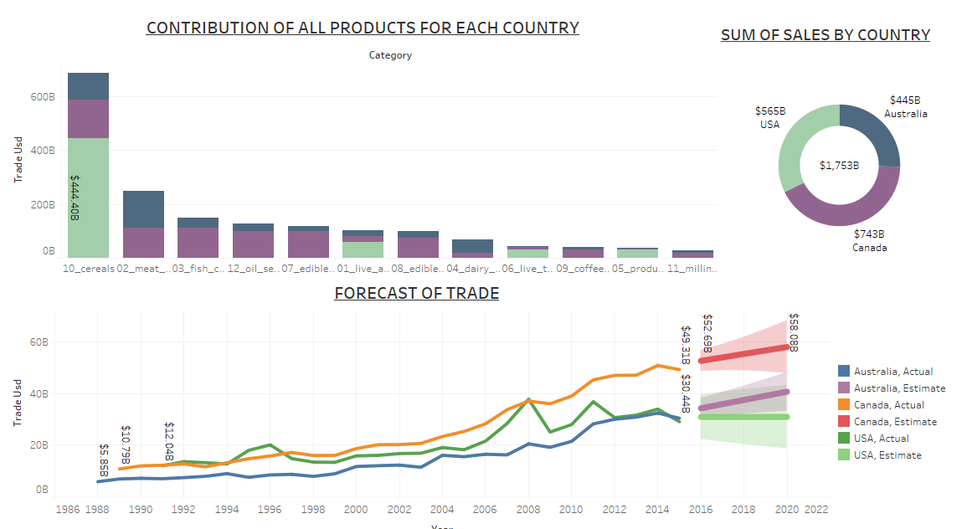
SLIDE 9

Slide 11
DASHBOARD - 3
BAR CHART
On this chart we get an idea of the exact location of the countries given in our dataset.
PIE CHART
This chart shows the overall sum of sales for each country.
FORECAST CHARTS
It shows the yearly future predicted sales of all the 3 countries in dollars.
INFERENCES FROM THE DASHBOARD
The projections are based on an assessment of the economic climate in individual countries and the world economy.
The indicator comprises the net trade of import and export with the market growth. It is measured in USD[Billions] for net trade.
Even while predicting the future trade for each products, we came to know that the trade of ‘cereals’ creeps up increasing for the next 5 years of trade.
The forecasting trade of USA remains constant in the future. Whereas, the forecasting of Canada and Australia increases higher in the future trade.
Canada - [2016 – $52.69B to 2020-$58.08B]
USA - [2016 – $30.96B to 2020-$30.96B]
Australia - [2016 – $34.32B to 2020-$40.73B]
SLIDE 10

Slide 12
INTERPRETATIONS
The top export and import destinations of India are United States, UAE, China, Hong Kong and Germany.
India has the Economic Complexity Index (ECI) of 0.36 making it the 45th most complex country. India trades 390 products with revealed comparative advantages meaning that it share of global exports is larger than what would we expect from the size of its trade economy and from the size of a product’s global market.
India imports ‘Alcohol’ majorly from USA that makes 1% of the entire import trade calculations and the sum value of $237M each year. Likewise, ‘Wine’ is imported from Australia at 0.028% of overall imports with the value of $4.13M each year.
From Canada, India imports ‘Edible preparation’ products at 0.034% with overall average trade value of $1.4M every year.
India’s Organic food market is expected to increase by 3 times by 2020. Also the government of India aims to boost the growth of dairy products and funded $1.4B in trade.
The government through the Ministry of Food Processing Industries(MFPI) is making all the efforts to encourage investments in trade business of dairy products.
Hence, If an Indian Manufacturing company wants to launch a new business unit focusing on global trade and logistics, the recommendations would be to consider the products such as ‘Wheat’ ; ‘Cereals’ and ‘Dairy products’ according to the real-time facts and the data provided.

Slide 13

BUSINESS
CHARACTER
THOUGH, THE PRESENTATION SLIDES EXPLAINS
IN-DEPTH ABOUT THE PROJECT, TO KNOW MORE ABOUT THE PROJECTS AND NEAT VISUALIZATION WITH INTRACTIVE TABLEAU DASHBOARDS FOR DEEP EXPLORATION OF THE PROJECT,
KINDLY CHECK OUT THE LINK BELOW FOR FURTHER INFORMATIONS.
LINK TO THE PROJECT :DASHBOARDS 1.https://public.tableau.com/profile/akilesh6341#!/vizhome/PROJECTTERM2/MAPOVERVIEW?publish=yes
2. https://public.tableau.com/profile/akilesh6341#!/vizhome/PROJECTTERM2/CONCENTRATIONOFPRODUCTS?publish=yes
3. https://public.tableau.com/profile/akilesh6341#!/vizhome/PROJECTTERM2/FORECAST?publish=yes
SLIDE 11

Slide 14


THANK YOU
YOU CAN FIND ME AT :
+91 9789779695
johnaki.777@gmail.com

